Slide 1
Women Business Agendas
PNG WBA Introductory Workshop
February 27, 2020
Barbara Langley
director of the Center for Women’s Economic Empowerment

Slide 2

Objectives
Understand the WBA process
Appreciate the WBA’s potential
Analyze how other countries have used the WBA process to improve the business environment for women
Agree on what next
  Discuss the potential for a WBA in PNG
  Develop an initial coalition
  Develop an initial plan to implement the process

Slide 3
Women’s Business Agendas
Process and examples

Slide 4

Five Questions for Today
What is an WBA?
How does it work?
How is it different from other PPD initiatives?
How can it drive economic progress?
What are some examples of successes (and failures)?

Slide 5

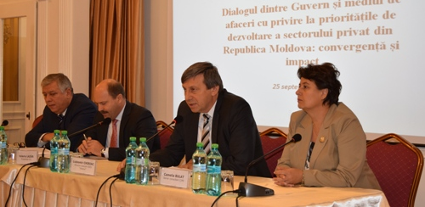

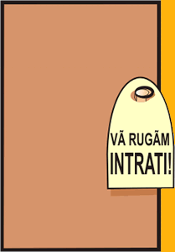

CIPE NBA Experiences
Worldwide, all levels, many contexts
Armenia
Azerbaijan
Belarus
Romania
Moldova
Montenegro
Algeria
Iraq
Egypt
Jordan
Afghanistan
Kenya
Ethiopia
Peru
Bangladesh

Slide 6


A Business Agenda is both a process and a product
PROCESS
Organized. A systematic private sector-driven PPD effort.
Democratic. Broad-based consultation, search for consensus, shared priorities.
Fact-based. Grounded in research.
Ongoing and iterative.
PRODUCT
Roadmap of well researched, specific reform recommendations.
Reforms are clear, specific.
Responds to needs of women in the private sector.
Notes:
Can be sectoral, provincial, regional

Slide 7
Steps
1. CONSULT
Hear different voices, understand problems, make connections, build buy-in and consensus
2. RESEARCH
Define priorities, develop recommendations
4. ADVOCATE
Launch the WBA, communicate and advocate.
5. MONITOR AND EVALUATE
Track steps taken toward reform, examine impact of implementation.
3. DEVELOP THE NBA
Create a clear roadmap of reforms.

Slide 8

1. Consult
Hear different voices, understand problems, make connections, build buy-in and consensus
Open, inclusive consultations
Identification of priority reform areas, consensus
Networks and credibility
Momentum and buy-in
Notes:
Ongoing, multi-stakeholder dialogue and consultation gives…
...Input (a reality check)
…Credibility
...Buy-in and support (one voice of many voices)
…Force multipliers
…Momentum
CONSIDERATIONS -
Is the issue important to…business? …policymakers? …citizens?…the country’s future?
How reliable/realistic is the research? Is the issue well understood?
Are there political dimensions?
What is the timeframe?

Slide 9

2. Research define priorities, develop recommendations
Investigate priority issues for women in business
Gather together the range of possible recommendations
Select final recommendations
Notes:
CONSIDERATIONS
Organization (group or committee work)
Requires expertise and thorough understanding of the issue
Too few? Too many?
Balance of short (quick, visible wins) and long-term

Slide 10

3. Develop the nba
Create a clear roadmap of reforms
Feedback and finalization
Structure
Substance
Level of detail
Length
Different versions for different audiences
Notes:
CONSIDERATIONS
STRUCTURE GENERALLY INCLUDES
Introduction (why the NBA, why now?)
Methodology
Context
Presentation of priority themes and rationale
Recommendations by these (supporting research, opposing views…)
Specific organization depends on country and context
Clear
Based in facts and needs
Creation of digestible versions for different audiences
Issues Statements (short and clear)
Brief overview of the issue
The supporting view of the Coalition
Opposing view
Policy recommendations

Slide 11

4. Advocate
Launch the Wba, communicate, and advocate
Launch event
Dissemination
Outreach meetings and events
Education and awareness campaigns
An ongoing process
Notes:
Coalitions

Slide 12
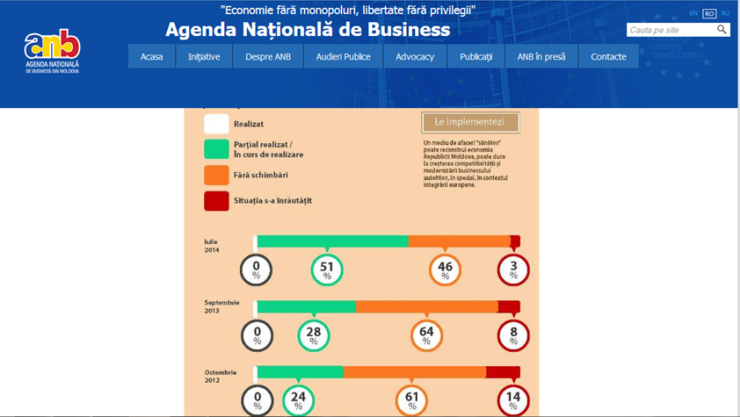
5. Monitor and evaluate track steps take toward reform, examine impact of implementation
Monitor for reform implementation, impact
Monitor the WBA initiative – levels of awareness, support keep public and decision makers updated on progress
Be public and transparent about successes, but also failures and things that
need improvement
Recognize allies and
supporters
Notes:
Reward officials
Track legislation
Publish voting records

Slide 13
WBA Sample timeline
Coalition Building = 1 to 3 Months
Steering Committee Organization
Goals/Objective Setting
Roles and Responsibilities
Government Buy-in
Issue Identification/Prioritization = 1 to 2 Months
Private Sector Townhalls
Focus Groups
Member Surveys
Research & Recommendations = 3 to 6 Months
Research Team
Legal/Regulatory/Social Norms Review
International Best Practice/Case Studies
First Draft
Coalition Feedback
Final Draft
Public Launch = 1 Month
Print/Electronic Copies
Press Conference
Government Buy-In
Advocacy Campaign = 6 months to 1 year
Public-Private Dialogue
Key Stakeholder Meetings
Coalition Efforts/Endorsements
Media
Evaluation = 1 to 3 Months
Legislative Tracking
Scorecards
Impact Analysis
Lessons Learned for Second Phase
Notes:
Reward officials
Track legislation
Publish voting records

Slide 14







Ingredients for Success
Systematic, organized process, with methodology, mechanisms
Broad-based, multi-way consultation and communication at all levels
Win-win approach, seeks areas of common purpose
Speaking with one voice on every issue
Specific, clear, realistic, research-based solutions that address systemic problems
Involvement and commitment from all stakeholders
Ongoing, iterative process

Slide 15

Common errors
Too many issues
Weak research or arguments
Limited buy-in (any level)
Too many “cooks in the kitchen”
Unclear process, roles during implementation

Slide 16
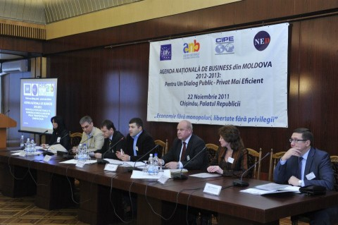
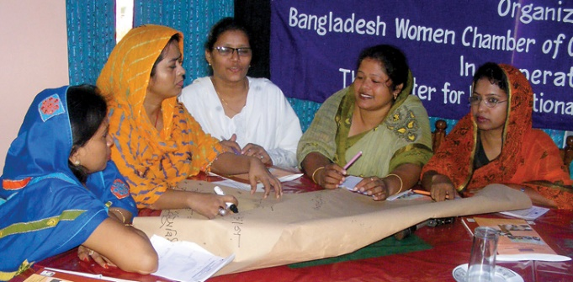
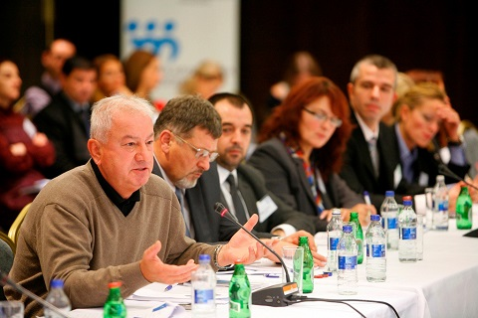
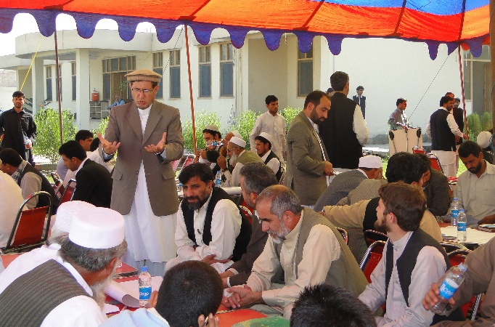
At best, Wbas can help transform both the economy and democracy—reform laws and change democratic values
  Lobbying → Advocacy
  Single interests → Broad policy issues
  One transaction → Systemic changes
  Behind-door deals → Open, constant dialogue
Notes:
Change not just in laws, but in behaviors

Slide 17

collective action!

Slide 18


Slide 19

Example: Bangladesh

Slide 20
National and Private Sector Context
Population of 164.7 million, densely populated
Widespread poverty, but improvements in economy recently
  Average 6% growth in recent years
Booming garment sector that has generated employment opportunities for urban women

Slide 21
Problems for Women
As Bangladesh’s economy grows:
Women businessowners move from microcredit to commercial bank loans. However, lack of credit and financial literacy, along with social norms make this difficult
Women move from informal to formal sector, facing regulatory and governance hurdles, and social barriers.

Slide 22
BWCCI & WNBA
Bangladesh Women’s Chamber of Commerce and Industry (BWCCI)
Women’s National Business Agenda (WNBA).
  Baseline assessment
  Advocacy meetings
  Official business agenda with 30 reform recommendations.
Notes:
With assistance from CIPE, the BWCCI was founded in 2001 by Selima Ahmad. BWCCI’s services now include business development, administrative support, and trade promotion. BWCCI now has over 3,500 members in several national branches.
In addition to these accomplishments, in 2009 the BWCCI developed Bangladesh’s first Women’s National Business Agenda (WNBA).
First, BWCCI conducted a baseline assessment on women entrepreneurs in Bangladesh to serve as starting point for policy recommendations.
Next, BWCCI held 32 advocacy meetings at the local and national levels. This included meetings with national government bodies, chambers of commerce, deputy commissioner offices, the media, think tanks, and NGOs.
In March 2009, BWCCI launched the official agenda that included 30 recommendations, covering social barriers, capacity building and training needs, and financial barriers. More than 180 organizations representing all six geographic divisions in Bangladesh endorsed the final agenda submitted to the government.

Slide 23
Progress
Central Bank issued instructions to commercial banks to increase lending to women-owned businesses.
Increase proportion of women entrepreneurs receiving commercial bank loans
  19% in 2007 → 50% in 2014
  More than $93 million in loans for SMEs to 10,000 women
More than 65% of the country’s banks staffing dedicated to desks for female borrowers

Slide 24

Example: AFghanistan

Slide 25
Afghanistan:
National Business agenda and
Provincial business agendas
Context
  Business associations and chambers of commerce were disbanded under Taliban rule, prior to 2001
  Country needed a unified voice for business
  Later, after troop drawdown, provinces outside Kabul were in need of economic revitalization
NBA Process
  Surveyed 700 businesses in major cities on priorities
  Three key areas: lack of security, corruption, unreliable supply of electricity
  Afghanistan Chamber of Commerce and Industry led coalition of 11 business associations
PBA Process
  NBA coalition members reached out to provincial chapters to organize PBA process in four provinces
  Advocacy Task Forces (ATFs) advocate for recommendations on local and national levels
Results
  Decreased price for electricity in industrial parks
  Construction of 5 new cold storage units for agricultural products in Balkh Province
Notes:
-NBA process in Afghanistan was launched in 2011; PBA process was launched in 2014 as a response to the economic hit provinces outside the capitol took as a result of the reduction of international troops
-NBA process surveyed stakeholders in 6 cities: Kabul, Herat, Kandahar, Mazar, Khost, Jalalabad; these cities would later serve as hubs for the PBA process
-the task force represented major sectoral organizations in Afghanistan and was gender inclusive
-NBA advocacy targeted MPs and went all the way up to the president; then-President Hamid Karzai met with the vice chair of ACCI to discuss NBA recommendations
-PBAs were created in Herat, Balkh, Nangarhar, and Kandahar; these provinces were focuses based on CIPE’s strong network in these regions and their strategic border locations; main hubs for trade
-ATFs organized in PBA process continue to advocate for PBA reforms today to the provincial and national government in each province
-Balkh result example included just as a “for instance” for PBA success; there are many additional examples as well!

Slide 26

Example: Jordan

Slide 27
Jordan: Young entrepreneurs association
Vision
To create an entrepreneurial and leadership culture as the cornerstone of national economic development
Context
High Unemployment
Erratic or poor business environment
99.6% of all registered companies are MSMEs.
These companies provide 52% of private sector jobs, 99% of employers
Process
Reviewed projects across multiple sectors and governorates
Crafted SMBA with recommendations across six pillars
Focus groups throughout Jordan to prioritize recommendations
Advocacy and engagement of Royal Court, Government and Parliament
Results
SMBA was almost entirely adopted for into national SME strategy
Notes:
Wide geographic focus groups increase credibility with GoJ.
SMBA validates SME national Strategy.

